Slide 1
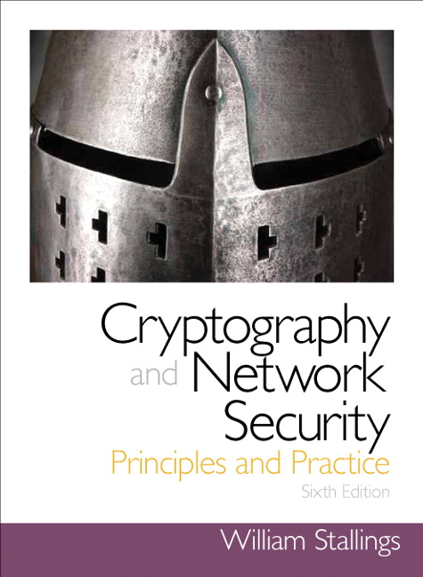
Cryptography and Network Security
Seventh Edition
by William Stallings
Notes:
Lecture slides prepared for “Cryptography and Network Security”, 7/e, by William Stallings, Chapter 12 – “Message Authentication Codes”.

Slide 2
Chapter 12
Message Authentication Codes
Notes:
One of the most fascinating and complex areas of cryptography is that of message
authentication and the related area of digital signatures. It would be impossible, in
anything less than book length, to exhaust all the cryptographic functions and protocols
that have been proposed or implemented for message authentication and digital
signatures. Instead, the purpose of this chapter and the next is to provide a broad
overview of the subject and to develop a systematic means of describing the various
approaches.
This chapter begins with an introduction to the requirements for authentication
and digital signature and the types of attacks to be countered. Then the basic
approaches are surveyed. The remainder of the chapter deals with the fundamental
approach to message authentication known as the message authentication code
(MAC). Following an overview of this topic, the chapter looks at security considerations
for MACs. This is followed by a discussion of specific MACs in two categories:
those built from cryptographic hash functions and those built using a block cipher
mode of operation. Next, we look at a relatively recent approach known as authenticated
encryption. Finally, we look at the use of cryptographic hash functions and
MACs for pseudorandom number generation.

Slide 3
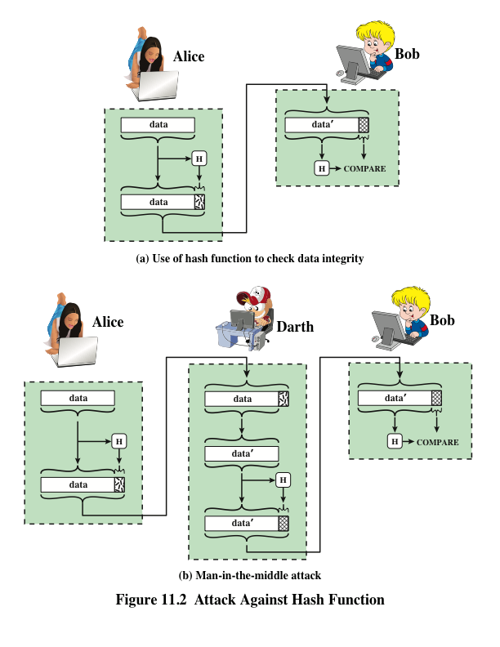
Hash Function Uses
Notes:
Message authentication is a mechanism or service used to verify the integrity of
a message. Message authentication assures that data received are exactly as sent
(i.e., contain no modification, insertion, deletion, or replay). In many cases, there is
a requirement that the authentication mechanism assures that purported identity of
the sender is valid. When a hash function is used to provide message authentication,
the hash function value is often referred to as a message digest .
The essence of the use of a hash function for message authentication is as
follows. The sender computes a hash value as a function of the bits in the message
and transmits both the hash value and the message. The receiver performs the same
hash calculation on the message bits and compares this value with the incoming
hash value. If there is a mismatch, the receiver knows that the message (or possibly
the hash value) has been altered (Figure 11.2a).
The hash function must be transmitted in a secure fashion. That is, the hash
function must be protected so that if an adversary alters or replaces the message,
it is not feasible for adversary to also alter the hash value to fool the receiver. This
type of attack is shown in Figure 11.2b. In this example, Alice transmits a data block
and attaches a hash value. Darth intercepts the message, alters or replaces the data
block, and calculates and attaches a new hash value. Bob receives the altered data
with the new hash value and does not detect the change. To prevent this attack, the
hash value generated by Alice must be protected.

Slide 4
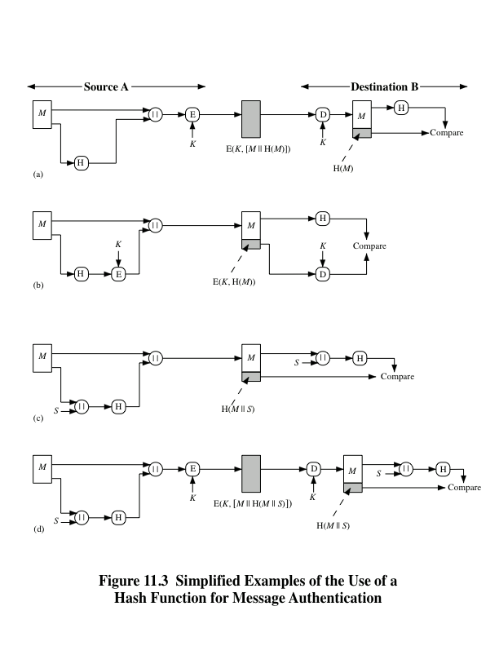
Notes:
Figure 11.3 illustrates a variety of ways in which a hash code can be used to
provide message authentication, as follows:
a. The message plus concatenated hash code is encrypted using symmetric
encryption. Because only A and B share the secret key, the message must
have come from A and has not been altered. The hash code provides the structure
or redundancy required to achieve authentication. Because encryption is
applied to the entire message plus hash code, confidentiality is also provided.
b. Only the hash code is encrypted, using symmetric encryption. This reduces the
processing burden for those applications that do not require confidentiality.
c. It is possible to use a hash function but no encryption for message authentication.
The technique assumes that the two communicating parties share a common secret
value S. A computes the hash value over the concatenation of M and S and
appends the resulting hash value to M. Because B possesses S, it can recompute
the hash value to verify. Because the secret value itself is not sent, an opponent
cannot modify an intercepted message and cannot generate a false message.
d. Confidentiality can be added to the approach of method (c) by encrypting the
entire message plus the hash code.
When confidentiality is not required, method (b) has an advantage over
methods (a) and (d), which encrypts the entire message, in that less computation
is required. Nevertheless, there has been growing interest in techniques that
avoid encryption (Figure 11.3c). Several reasons for this interest are pointed out in
[TSUD92].
• Encryption software is relatively slow. Even though the amount of data to be
encrypted per message is small, there may be a steady stream of messages into
and out of a system.
• Encryption hardware costs are not negligible. Low-cost chip implementations
of DES are available, but the cost adds up if all nodes in a network must have
this capability.
• Encryption hardware is optimized toward large data sizes. For small blocks
of data, a high proportion of the time is spent in initialization/invocation
overhead.
• Encryption algorithms may be covered by patents, and there is a cost associated
with licensing their use.

Slide 5
Message Authentication Requirements
Disclosure
Release of message contents to any person or process not possessing the appropriate cryptographic key
Traffic analysis
Discovery of the pattern of traffic between parties
Masquerade
Insertion of messages into the network from a fraudulent source
Content modification
Changes to the contents of a message, including insertion, deletion, transposition, and modification
Sequence modification
Any modification to a sequence of messages between parties, including insertion, deletion, and reordering
Timing modification
Delay or replay of messages
Source repudiation
Denial of transmission of message by source
Destination repudiation
Denial of receipt of message by destination
Notes:
In the context of communications across a network, the following attacks can be
identified.
1. Disclosure: Release of message contents to any person or process not possessing
the appropriate cryptographic key.
2. Traffic analysis: Discovery of the pattern of traffic between parties. In a connection-
oriented application, the frequency and duration of connections could
be determined. In either a connection-oriented or connectionless environment,
the number and length of messages between parties could be determined.
3. Masquerade: Insertion of messages into the network from a fraudulent source.
This includes the creation of messages by an opponent that are purported to
come from an authorized entity. Also included are fraudulent acknowledgments
of message receipt or nonreceipt by someone other than the message recipient.
4. Content modification: Changes to the contents of a message, including insertion,
deletion, transposition, and modification.
5. Sequence modification: Any modification to a sequence of messages between
parties, including insertion, deletion, and reordering.
6. Timing modification: Delay or replay of messages. In a connection-oriented
application, an entire session or sequence of messages could be a replay of
some previous valid session, or individual messages in the sequence could be
delayed or replayed. In a connectionless application, an individual message
(e.g., datagram) could be delayed or replayed.
7. Source repudiation: Denial of transmission of message by source.
8. Destination repudiation: Denial of receipt of message by destination.
Measures to deal with the first two attacks are in the realm of message confidentiality
and are dealt with in Part One. Measures to deal with items (3) through (6)
in the foregoing list are generally regarded as message authentication. Mechanisms
for dealing specifically with item (7) come under the heading of digital signatures.
Generally, a digital signature technique will also counter some or all of the attacks
listed under items (3) through (6). Dealing with item (8) may require a combination
of the use of digital signatures and a protocol designed to counter this attack.
In summary, message authentication is a procedure to verify that received
messages come from the alleged source and have not been altered. Message authentication
may also verify sequencing and timeliness. A digital signature is an authentication
technique that also includes measures to counter repudiation by the source.

Slide 6
Message Authentication Functions
Two levels of functionality:
Hash function
A function that maps a message of any length into a fixed-length hash value which serves as the authenticator
Message encryption
The ciphertext of the entire message serves as its authenticator
Message authentication code (MAC)
A function of the message and a secret key that produces a fixed-length value that serves as the authenticator
Lower level
There must be some sort of function that produces an authenticator
Higher-level
Uses the lower-level function as a primitive in an authentication protocol that enables a receiver to verify the authenticity of a message
Notes:
Any message authentication or digital signature mechanism has two levels of functionality.
At the lower level, there must be some sort of function that produces
an authenticator: a value to be used to authenticate a message. This lower-level
function is then used as a primitive in a higher-level authentication protocol that
enables a receiver to verify the authenticity of a message.
This section is concerned with the types of functions that may be used to produce
an authenticator. These may be grouped into three classes.
• Hash function: A function that maps a message of any length into a fixed-length
hash value, which serves as the authenticator
• Message encryption: The ciphertext of the entire message serves as its
authenticator
• Message authentication code (MAC): A function of the message and a secret
key that produces a fixed-length value that serves as the authenticator
Hash functions, and how they may serve for message authentication, are discussed
in Chapter 11. The remainder of this section briefly examines the remaining
two topics. The remainder of the chapter elaborates on the topic of MACs.

Slide 7
Message Authentication Code (MAC)
Also known as a keyed hash function
Typically used between two parties that share a secret key to authenticate information exchanged between those parties
Takes as input a secret key and a data block and produces a hash value (MAC) which is associated with the protected message
If the integrity of the message needs to be checked, the MAC function can be applied to the message and the result compared with the associated MAC value
An attacker who alters the message will be unable to alter the associated MAC value without knowledge of the secret key
Notes:
More commonly, message authentication is achieved using a message authentication
code (MAC ), also known as a keyed hash function . Typically, MACs are
used between two parties that share a secret key to authenticate information exchanged
between those parties. A MAC function takes as input a secret key and a
data block and produces a hash value, referred to as the MAC, which is associated
with the protected message. If the integrity of the message needs to be checked, the
MAC function can be applied to the message and the result compared with the associated
MAC value. An attacker who alters the message will be unable to alter the
associated MAC value without knowledge of the secret key. Note that the verifying
party also knows who the sending party is because no one else knows the secret key.
Note that the combination of hashing and encryption results in an overall
function that is, in fact, a MAC (Figure 11.3b). That is, E(K , H(M )) is a function of
a variable-length message M and a secret key K , and it produces a fixed-size output
that is secure against an opponent who does not know the secret key. In practice,
specific MAC algorithms are designed that are generally more efficient than an encryption
algorithm.

Slide 8
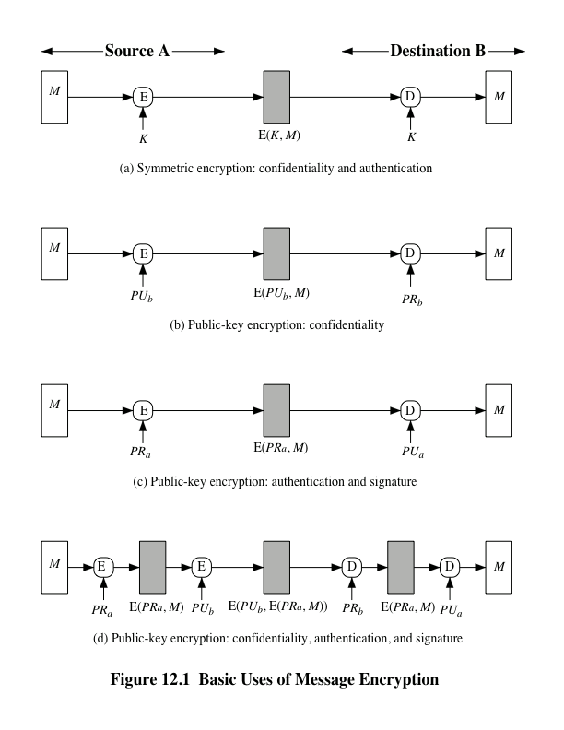
Notes:
Consider the straightforward use of symmetric encryption
(Figure 12.1a). A message M transmitted from source A to destination B is encrypted
using a secret key K shared by A and B. If no other party knows the key,
then confidentiality is provided: No other party can recover the plaintext of the
message.
In addition, B is assured that the message was generated by A. Why? The
message must have come from A, because A is the only other party that possesses
K and therefore the only other party with the information necessary to construct
ciphertext that can be decrypted with K. Furthermore, if M is recovered, B knows
that none of the bits of M have been altered, because an opponent that does not
know K would not know how to alter bits in the ciphertext to produce the desired
changes in the plaintext.
So we may say that symmetric encryption provides authentication as well as
confidentiality. However, this flat statement needs to be qualified. Consider exactly
what is happening at B. Given a decryption function D and a secret key K, the
destination will accept any input X and produce output Y = D (K , X ). If X is the ciphertext
of a legitimate message M produced by the corresponding encryption function,
then Y is some plaintext message M. Otherwise, Y will likely be a meaningless
sequence of bits. There may need to be some automated means of determining at B
whether Y is legitimate plaintext and therefore must have come from A.
The implications of the line of reasoning in the preceding paragraph are profound
from the point of view of authentication. Suppose the message M can be any
arbitrary bit pattern. In that case, there is no way to determine automatically, at the
destination, whether an incoming message is the ciphertext of a legitimate message.
This conclusion is incontrovertible: If M can be any bit pattern, then regardless of
the value of X, the value Y = D(K , X ) is some bit pattern and therefore must be
accepted as authentic plaintext.
Thus, in general, we require that only a small subset of all possible bit patterns
be considered legitimate plaintext. In that case, any spurious ciphertext is unlikely
to produce legitimate plaintext. For example, suppose that only one bit pattern in
10⁶ is legitimate plaintext. Then the probability that any randomly chosen bit pattern,
treated as ciphertext, will produce a legitimate plaintext message is only 10⁻⁶ .

Slide 9
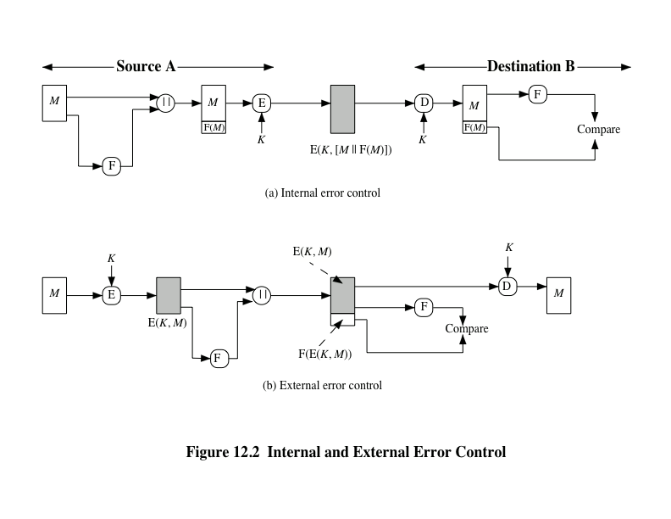
Notes:
It may be difficult to determine automatically if incoming ciphertext decrypts
to intelligible plaintext. If the plaintext is, say, a binary object file or digitized
X-rays, determination of properly formed and therefore authentic plaintext may
be difficult. Thus, an opponent could achieve a certain level of disruption simply by
issuing messages with random content purporting to come from a legitimate user.
One solution to this problem is to force the plaintext to have some structure
that is easily recognized but that cannot be replicated without recourse to the encryption
function. We could, for example, append an error-detecting code, also
known as a frame check sequence (FCS) or checksum, to each message before encryption,
as illustrated in Figure 12.2a. A prepares a plaintext message M and then
provides this as input to a function F that produces an FCS. The FCS is appended to
M and the entire block is then encrypted. At the destination, B decrypts the incoming
block and treats the results as a message with an appended FCS. B applies the
same function F to attempt to reproduce the FCS. If the calculated FCS is equal to
the incoming FCS, then the message is considered authentic. It is unlikely that any
random sequence of bits would exhibit the desired relationship.
Note that the order in which the FCS and encryption functions are performed
is critical. The sequence illustrated in Figure 12.2a is referred to in [DIFF79] as
internal error control , which the authors contrast with external error control
(Figure 12.2b). With internal error control, authentication is provided because an
opponent would have difficulty generating ciphertext that, when decrypted, would
have valid error control bits. If instead the FCS is the outer code, an opponent can
construct messages with valid error-control codes. Although the opponent cannot
know what the decrypted plaintext will be, he or she can still hope to create confusion
and disrupt operations.

Slide 10
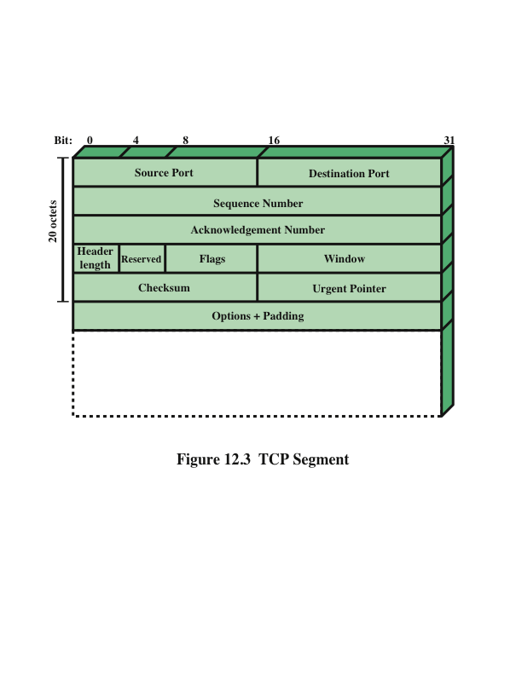
Notes:
An error-control code is just one example; in fact, any sort of structuring
added to the transmitted message serves to strengthen the authentication capability.
Such structure is provided by the use of a communications architecture consisting
of layered protocols. As an example, consider the structure of messages transmitted
using the TCP/IP protocol architecture. Figure 12.3 shows the format of a TCP
segment, illustrating the TCP header. Now suppose that each pair of hosts shared
a unique secret key, so that all exchanges between a pair of hosts used the same
key, regardless of application. Then we could simply encrypt all of the datagram except
the IP header. Again, if an opponent substituted some arbitrary bit pattern for
the encrypted TCP segment, the resulting plaintext would not include a meaningful
header. In this case, the header includes not only a checksum (which covers the
header) but also other useful information, such as the sequence number. Because
successive TCP segments on a given connection are numbered sequentially, encryption
assures that an opponent does not delay, misorder, or delete any segments.

Slide 11
Public-Key Encryption
The straightforward use of public-key encryption provides confidentiality but not authentication
To provide both confidentiality and authentication, A can encrypt M first using its private key which provides the digital signature, and then using B’s public key, which provides confidentiality
Disadvantage is that the public-key algorithm must be exercised four times rather than two in each communication
Notes:
The straightforward use of public-key encryption
(Figure 12.1b) provides confidentiality but not authentication. The source (A) uses
the public key PU_{b} of the destination (B) to encrypt M . Because only B has the corresponding
private key PR_{b} , only B can decrypt the message. This scheme provides
no authentication, because any opponent could also use B’s public key to encrypt a
message and claim to be A.
To provide authentication, A uses its private key to encrypt the message, and
B uses A’s public key to decrypt (Figure 12.1c). This provides authentication using
the same type of reasoning as in the symmetric encryption case: The message must
have come from A because A is the only party that possesses PR_{a} and therefore
the only party with the information necessary to construct ciphertext that can be
decrypted with PU_{a} . Again, the same reasoning as before applies: There must be
some internal structure to the plaintext so that the receiver can distinguish between
well-formed plaintext and random bits.
Assuming there is such structure, then the scheme of Figure 12.1c does provide
authentication. It also provides what is known as digital signature. Only A
could have constructed the ciphertext because only A possesses PR_{a} . Not even B,
the recipient, could have constructed the ciphertext. Therefore, if B is in possession
of the ciphertext, B has the means to prove that the message must have come
from A. In effect, A has “signed” the message by using its private key to encrypt.
Note that this scheme does not provide confidentiality. Anyone in possession of A’s
public key can decrypt the ciphertext.
To provide both confidentiality and authentication, A can encrypt M first
using its private key, which provides the digital signature, and then using B’s public
key, which provides confidentiality (Figure 12.1d). The disadvantage of this approach
is that the public-key algorithm, which is complex, must be exercised four
times rather than two in each communication.

Slide 12
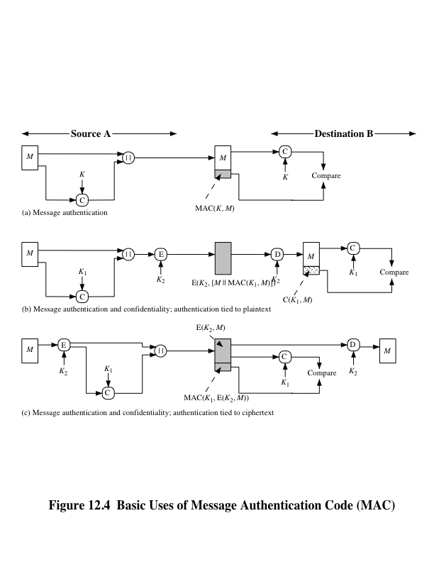
Notes:
An alternative authentication technique involves the use of a secret key to generate
a small fixed-size block of data, known as a cryptographic checksum or MAC, that is
appended to the message. This technique assumes that two communicating parties,
say A and B, share a common secret key K. When A has a message to send to B, it
calculates the MAC as a function of the message and the key:
MAC = C(K , M )
where
M = input message
C = MAC function
K = shared secret key
MAC = message authentication code
The message plus MAC are transmitted to the intended recipient. The recipient
performs the same calculation on the received message, using the same secret key,
to generate a new MAC. The received MAC is compared to the calculated MAC
(Figure 12.4a). If we assume that only the receiver and the sender know the identity
of the secret key, and if the received MAC matches the calculated MAC, then
1. The receiver is assured that the message has not been altered. If an attacker
alters the message but does not alter the MAC, then the receiver’s calculation
of the MAC will differ from the received MAC. Because the attacker is assumed
not to know the secret key, the attacker cannot alter the MAC to correspond
to the alterations in the message.
2. The receiver is assured that the message is from the alleged sender. Because
no one else knows the secret key, no one else could prepare a message with a
proper MAC.
3. If the message includes a sequence number (such as is used with HDLC, X.25,
and TCP), then the receiver can be assured of the proper sequence because an
attacker cannot successfully alter the sequence number.
A MAC function is similar to encryption. One difference is that the MAC
algorithm need not be reversible, as it must be for decryption. In general, the MAC
function is a many-to-one function. The domain of the function consists of messages
of some arbitrary length, whereas the range consists of all possible MACs and all
possible keys. If an n -bit MAC is used, then there are 2^{n} possible MACs, whereas
there are N possible messages with N >> 2^{n} . Furthermore, with a k -bit key, there
are 2^{k} possible keys.
The process depicted in Figure 12.4a provides authentication but not confidentiality,
because the message as a whole is transmitted in the clear. Confidentiality
can be provided by performing message encryption either after (Figure 12.4b) or
before (Figure 12.4c) the MAC algorithm. In both these cases, two separate keys are
needed, each of which is shared by the sender and the receiver. In the first case, the
MAC is calculated with the message as input and is then concatenated to the message.
The entire block is then encrypted. In the second case, the message is encrypted
first. Then the MAC is calculated using the resulting ciphertext and is concatenated
to the ciphertext to form the transmitted block. Typically, it is preferable to tie the
authentication directly to the plaintext, so the method of Figure 12.4b is used.

Slide 13
Requirements for MACs
Taking into account the types of attacks, the MAC needs to satisfy the following:
The first requirement deals with message replacement attacks, in which an opponent is able to construct a new message to match a given MAC, even though the opponent does not know and does not learn the key
The second requirement deals with the need to thwart a brute-force attack based on chosen plaintext
The final requirement dictates that the authentication algorithm should not be weaker with respect to certain parts or bits of the message than others
Notes:
In assessing the security of a MAC function, we need to consider the types of attacks that may be mounted against it. Hence it needs to satisfy the listed requirements.
The first requirement deals with message replacement attacks, in which an opponent is able to construct a new message to match a given MAC, even though the opponent does not know and does not learn the key.
The second requirement deals with the need to thwart a brute-force attack based on chosen plaintext.
The final requirement dictates that the authentication algorithm should not be weaker with respect to certain parts or bits of the message than others.

Slide 14
Brute-Force Attack
Requires known message-tag pairs
A brute-force method of finding a collision is to pick a random bit string y and check if H(y) = H(x)
Two lines of attack:
Attack the key space
If an attacker can determine the MAC key then it is possible to generate a valid MAC value for any input x
Attack the MAC value
Objective is to generate a valid tag for a given message or to find a message that matches a given tag
Notes:
A brute-force attack on a MAC is a more difficult undertaking than a brute-force
attack on a hash function because it requires known message-tag pairs. Let us see
why this is so. To attack a hash code, we can proceed in the following way. Given
a fixed message x with n-bit hash code h = H(x ), a brute-force method of finding
a collision is to pick a random bit string y and check if H(y) = H(x). The attacker
can do this repeatedly off line. Whether an off-line attack can be used on a MAC
algorithm depends on the relative size of the key and the tag.
The attacker would like to come up with the valid MAC code for a
given message x. There are two lines of attack possible: attack the key space and
attack the MAC value. We examine each of these in turn.
If an attacker can determine the MAC key, then it is possible to generate a
valid MAC value for any input x. Suppose the key size is k bits and that the attacker
has one known text-tag pair. Then the attacker can compute the n-bit tag on the
known text for all possible keys. At least one key is guaranteed to produce the correct
tag, namely, the valid key that was initially used to produce the known text-tag
pair. This phase of the attack takes a level of effort proportional to 2^{k} (that is, one
operation for each of the 2^{k} possible key values). However, as was described earlier,
because the MAC is a many-to-one mapping, there may be other keys that produce
the correct value. Thus, if more than one key is found to produce the correct value,
additional text-tag pairs must be tested. It can be shown that the level of effort
drops off rapidly with each additional text-MAC pair and that the overall level of
effort is roughly 2^{k} [MENE97].
An attacker can also work on the tag without attempting to recover the key.
Here, the objective is to generate a valid tag for a given message or to find a message
that matches a given tag. In either case, the level of effort is comparable to that for
attacking the one-way or weak collision-resistant property of a hash code, or 2^{n}. In
the case of the MAC, the attack cannot be conducted off line without further input;
the attacker will require chosen text-tag pairs or knowledge of the key.
To summarize, the level of effort for brute-force attack on a MAC algorithm
can be expressed as min(2^{k}, 2^{n}). The assessment of strength is similar to that for
symmetric encryption algorithms. It would appear reasonable to require that the
key length and tag length satisfy a relationship such as min(k,n) ≥ N , where N is
perhaps in the range of 128 bits.

Slide 15
Cryptanalysis
Cryptanalytic attacks seek to exploit some property of the algorithm to perform some attack other than an exhaustive search
An ideal MAC algorithm will require a cryptanalytic effort greater than or equal to the brute-force effort
There is much more variety in the structure of MACs than in hash functions, so it is difficult to generalize about the cryptanalysis of MACs
Notes:
As with encryption algorithms and hash functions, cryptanalytic attacks on MAC
algorithms seek to exploit some property of the algorithm to perform some attack
other than an exhaustive search. The way to measure the resistance of a MAC algorithm
to cryptanalysis is to compare its strength to the effort required for a brute-force
attack. That is, an ideal MAC algorithm will require a cryptanalytic effort
greater than or equal to the brute-force effort.
There is much more variety in the structure of MACs than in hash functions,
so it is difficult to generalize about the cryptanalysis of MACs. Furthermore, far less
work has been done on developing such attacks. A useful survey of some methods
for specific MACs is [PREN96].

Slide 16
Message Authentication Code
MAC=C(K,M)
Cryptographic checksum.
MAC and M are transmitted together.
Non-reversible,
Receiver compares the received and the calculated MACs.

Slide 17
MACs Based on Hash Functions: HMAC
There has been increased interest in developing a MAC derived from a cryptographic hash function
Motivations:
Cryptographic hash functions such as MD5 and SHA generally execute faster in software than symmetric block ciphers such as DES
Library code for cryptographic hash functions is widely available
HMAC has been chosen as the mandatory-to-implement MAC for IP security
Has also been issued as a NIST standard (FIPS 198)
Notes:
Later in this chapter, we look at examples of a MAC based on the use of a symmetric
block cipher. This has traditionally been the most common approach to
constructing a MAC. In recent years, there has been increased interest in developing
a MAC derived from a cryptographic hash function. The motivations for this
interest are
1. Cryptographic hash functions such as MD5 and SHA generally execute faster
in software than symmetric block ciphers such as DES.
2. Library code for cryptographic hash functions is widely available.
With the development of AES and the more widespread availability of code
for encryption algorithms, these considerations are less significant, but hash-based
MACs continue to be widely used.
A hash function such as SHA was not designed for use as a MAC and cannot
be used directly for that purpose, because it does not rely on a secret key.
There have been a number of proposals for the incorporation of a secret key into
an existing hash algorithm. The approach that has received the most support is
HMAC [BELL96a, BELL96b]. HMAC has been issued as RFC 2104, has been
chosen as the mandatory-to-implement MAC for IP security, and is used in other
Internet protocols, such as SSL. HMAC has also been issued as a NIST standard
(FIPS 198).

Slide 18
HMAC Design Objectives
RFC 2104 lists the following objectives for HMAC:
To use, without modifications, available hash functions
To allow for easy replaceability of the embedded hash function in case faster or more secure hash functions are found or required
To preserve the original performance of the hash function without incurring a significant degradation
To use and handle keys in a simple way
To have a well understood cryptographic analysis of the strength of the authentication mechanism based on reasonable assumptions about the embedded hash function
Notes:
RFC 2104 lists the following design objectives for HMAC:
• To use, without modifications, available hash functions. In particular, hash functions that perform well in software, and for which code is freely and widely available.
• To allow for easy replaceability of the embedded hash function in case faster or more secure hash functions are found or required.
• To preserve the original performance of the hash function without incurring a significant degradation.
• To use and handle keys in a simple way.
• To have a well understood cryptographic analysis of the strength of the authentication mechanism based on reasonable assumptions about the embedded hash function.
The first two objectives are important to the acceptability of HMAC. HMAC
treats the hash function as a “black box.” This has two benefits. First, an existing
implementation of a hash function can be used as a module in implementing HMAC.
In this way, the bulk of the HMAC code is prepackaged and ready to use without
modification. Second, if it is ever desired to replace a given hash function in an
HMAC implementation, all that is required is to remove the existing hash function
module and drop in the new module. This could be done if a faster hash function were
desired. More important, if the security of the embedded hash function were compromised,
the security of HMAC could be retained simply by replacing the embedded
hash function with a more secure one (e.g., replacing SHA- 2 with SHA-3).
The last design objective in the preceding list is, in fact, the main advantage
of HMAC over other proposed hash-based schemes. HMAC can be proven secure
provided that the embedded hash function has some reasonable cryptographic
strengths. We return to this point later in this section, but first we examine the structure
of HMAC.

Slide 19
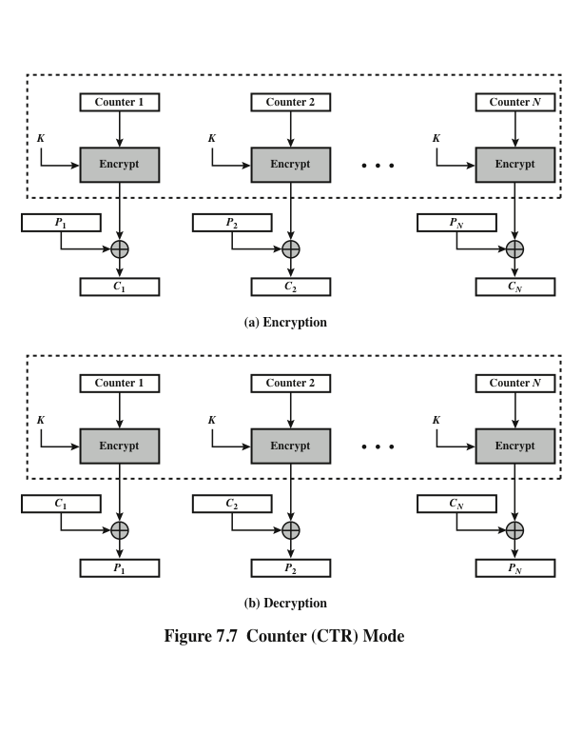
Notes:
Although interest in the counter (CTR) mode has increased recently with applications
to ATM (asynchronous transfer mode) network security and IP sec (IP security),
this mode was proposed early on (e.g., [DIFF79]).
Figure 7.7 depicts the CTR mode. A counter equal to the plaintext block
size is used. The only requirement stated in SP 800-38A is that the counter value
must be different for each plaintext block that is encrypted. Typically, the counter
is initialized to some value and then incremented by 1 for each subsequent block
(modulo 2^{b} , where b is the block size). For encryption, the counter is encrypted and
then XORed with the plaintext block to produce the ciphertext block; there is no
chaining. For decryption, the same sequence of counter values is used, with each encrypted
counter XORed with a ciphertext block to recover the corresponding plaintext
block. Thus, the initial counter value must be made available for decryption.
As with the OFB mode, the initial counter value must be a nonce; that is, T₁
must be different for all of the messages encrypted using the same key. Further,
all T_{i} values across all messages must be unique. If, contrary to this requirement, a
counter value is used multiple times, then the confidentiality of all of the plaintext
blocks corresponding to that counter value may be compromised. In particular, if
any plaintext block that is encrypted using a given counter value is known, then
the output of the encryption function can be determined easily from the associated
ciphertext block. This output allows any other plaintext blocks that are encrypted
using the same counter value to be easily recovered from their associated ciphertext
blocks.
One way to ensure the uniqueness of counter values is to continue to increment
the counter value by 1 across messages. That is, the first counter value of the
each message is one more than the last counter value of the preceding message.

Slide 20
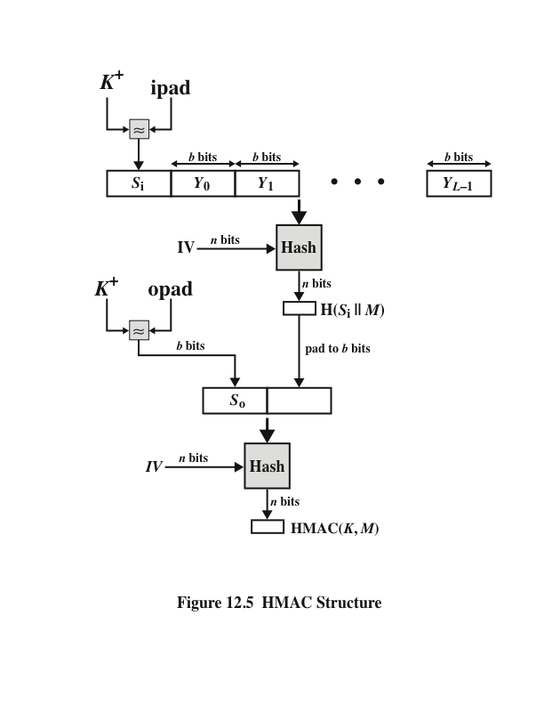
Notes:
Figure 12.5 illustrates the overall operation of HMAC.

Slide 21
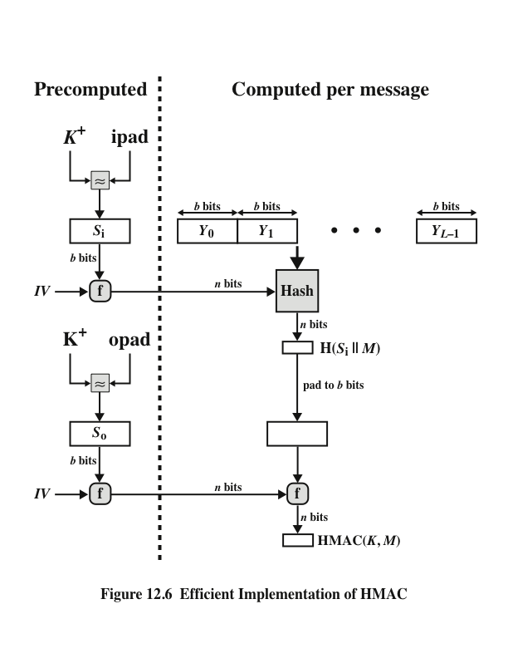
Notes:
A more efficient implementation is possible, as shown in Figure 12.6.

Slide 22
Security of HMAC
Depends in some way on the cryptographic strength of the underlying hash function
Appeal of HMAC is that its designers have been able to prove an exact relationship between the strength of the embedded hash function and the strength of HMAC
Generally expressed in terms of the probability of successful forgery with a given amount of time spent by the forger and a given number of message-tag pairs created with the same key
Notes:
The security of any MAC function based on an embedded hash function depends
in some way on the cryptographic strength of the underlying hash function. The
appeal of HMAC is that its designers have been able to prove an exact relationship
between the strength of the embedded hash function and the strength
of HMAC.
The security of a MAC function is generally expressed in terms of the probability
of successful forgery with a given amount of time spent by the forger and
a given number of message-tag pairs created with the same key. In essence, it is
proved in [BELL96a] that for a given level of effort (time, message–tag pairs) on
messages generated by a legitimate user and seen by the attacker, the probability
of successful attack on HMAC is equivalent to one of the following attacks on the
embedded hash function.
1. The attacker is able to compute an output of the compression function even
with an IV that is random, secret, and unknown to the attacker.
2. The attacker finds collisions in the hash function even when the IV is random
and secret.

Slide 23
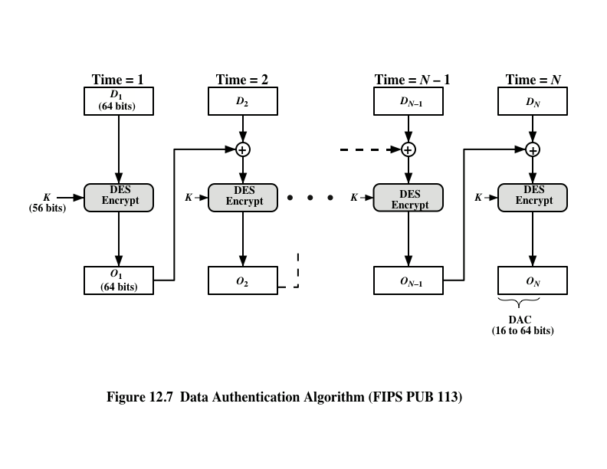
Notes:
The Data Authentication Algorithm (DAA), based on DES, has been one of the
most widely used MACs for a number of years. The algorithm is both a FIPS publication
(FIPS PUB 113) and an ANSI standard (X9.17). However, as we discuss
subsequently, security weaknesses in this algorithm have been discovered, and it is
being replaced by newer and stronger algorithms.
The algorithm can be defined as using the cipher block chaining (CBC) mode
of operation of DES (Figure 6.4) with an initialization vector of zero. The data (e.g.,
message, record, file, or program) to be authenticated are grouped into contiguous
64-bit blocks: D₁ , D₂ ,. . . , D_{N} . If necessary, the final block is padded on the right with
zeroes to form a full 64-bit block. Using the DES encryption algorithm E and a secret
key K , a data authentication code (DAC) is calculated as follows (Figure 12.7).

Slide 24
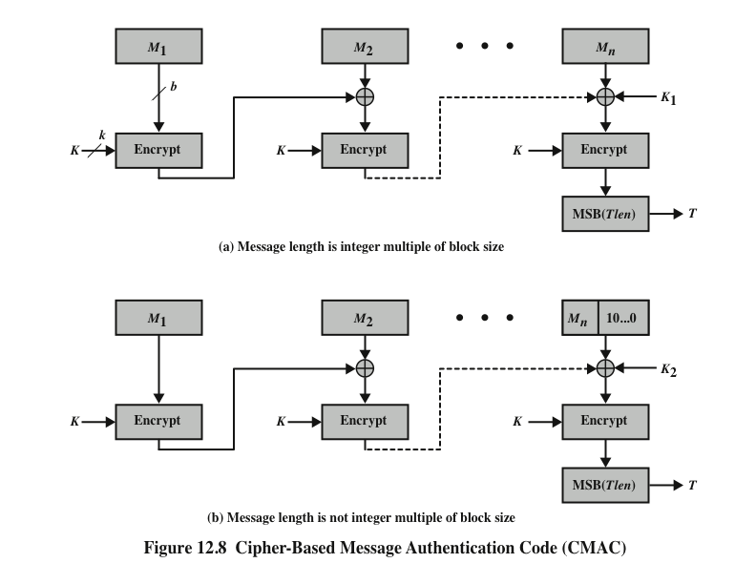
Notes:
As was mentioned, DAA has been widely adopted in government and industry.
[BELL00] demonstrated that this MAC is secure under a reasonable set of security
criteria, with the following restriction. Only messages of one fixed length of mn bits
are processed, where n is the cipher block size and m is a fixed positive integer.
CMAC is calculated as follows: (Figure 12.8).
It is specified in NIST Special Publication 800-38B.

Slide 25
Authenticated Encryption (AE)
A term used to describe encryption systems that simultaneously protect confidentiality and authenticity of communications
Approaches:
Hashing followed by encryption
Authentication followed by encryption
Encryption followed by authentication
Independently encrypt and authenticate
Both decryption and verification are straightforward for each approach
There are security vulnerabilities with all of these approaches
Notes:
Authenticated encryption (AE) is a term used to describe encryption systems that
simultaneously protect confidentiality and authenticity (integrity) of communications.
Many applications and protocols require both forms of security, but until recently
the two services have been designed separately.
There are four common approaches to providing both confidentiality
and encryption for a message M.
• Hashing followed by encryption. First compute the cryptographic hash function over
M as h = H (M ). Then encrypt the message plus hash function: E(K , (M ||h )).
• Authentication followed by encryption. Use two keys. First authenticate the plaintext by
computing the MAC value as T = MAC(K₁ , M ). Then encrypt the message
plus tag: E(K₂ , [M || T ]). This approach is taken by the SSL/TLS protocols
(Chapter 17).
• Encryption followed by authentication. Use two keys. First encrypt the message to
yield the ciphertext C = E(K₂ , M ). Then authenticate the ciphertext with
T = MAC(K₁ , C ) to yield the pair (C , T ). This approach is used in the IPsec
protocol (Chapter 20).
• Independently encrypt and authenticate. Use two keys. Encrypt the message to yield the ciphertext
C = E(K₂ , M ). Authenticate the plaintext with T = MAC(K₁ , M ) to
yield the pair (C , T ). These operations can be performed in either order. This
approach is used by the SSH protocol (Chapter 17).
Both decryption and verification are straightforward for each approach. For
H-E, M-E, and E+A, decrypt first, then verify. For E-A, verify first, then decrypt.
There are security vulnerabilities with all of these approaches. The H-E approach
is used in the Wired Equivalent Privacy (WEP) protocol to protect WiFi networks.
This approach had fundamental weaknesses and led to the replacement of the WEP
protocol. [BLAC05] and [BELL00] point out that there are security concerns in
each of the three encryption/MAC approaches listed above. Nevertheless, with
proper design, any of these approaches can provide a high level of security. This is
the goal of the two approaches discussed in this section, both of which have been
standardized by NIST.

Slide 26
Counter with Cipher Block Chaining-Message Authentication Code (CCM)
Was standardized by NIST specifically to support the security requirements of IEEE 802.11 WiFi wireless local area networks
Variation of the encrypt-and-MAC approach to authenticated encryption
Defined in NIST SP 800-38C
Key algorithmic ingredients:
AES encryption algorithm
CTR mode of operation
CMAC authentication algorithm
Single key K is used for both encryption and MAC algorithms
Notes:
The CCM mode of operation was standardized by NIST specifically to support
the security requirements of IEEE 802.11 WiFi wireless local area networks
(Chapter 18), but can be used in any networking application requiring authenticated
encryption. CCM is a variation of the encrypt-and-MAC approach to authenticated
encryption. It is defined in NIST SP 800-38C.
The key algorithmic ingredients of CCM are the AES encryption algorithm
(Chapter 6), the CTR mode of operation (Chapter 7), and the CMAC authentication
algorithm (Section 12.6). A single key K is used for both encryption and MAC
algorithms.

Slide 27
The input to the CCM encryption process consists of three elements:
Data that will be both authenticated and encrypted
This is the plaintext message P of the data block
Associated data A that will be authenticated but not encrypted
An example is a protocol header that must be transmitted in the clear for proper protocol operation but which needs to be authenticated
A nonce N that is assigned to the payload and the associated data
This is a unique value that is different for every instance during the lifetime of a protocol association and is intended to prevent replay attacks and certain other types of attacks
Notes:
The input to the CCM encryption process consists of three elements.
1. Data that will be both authenticated and encrypted. This is the plaintext message
P of data block.
2. Associated data A that will be authenticated but not encrypted. An example
is a protocol header that must be transmitted in the clear for proper protocol
operation but which needs to be authenticated.
3. A nonce N that is assigned to the payload and the associated data. This is a
unique value that is different for every instance during the lifetime of a protocol
association and is intended to prevent replay attacks and certain other
types of attacks.

Slide 28
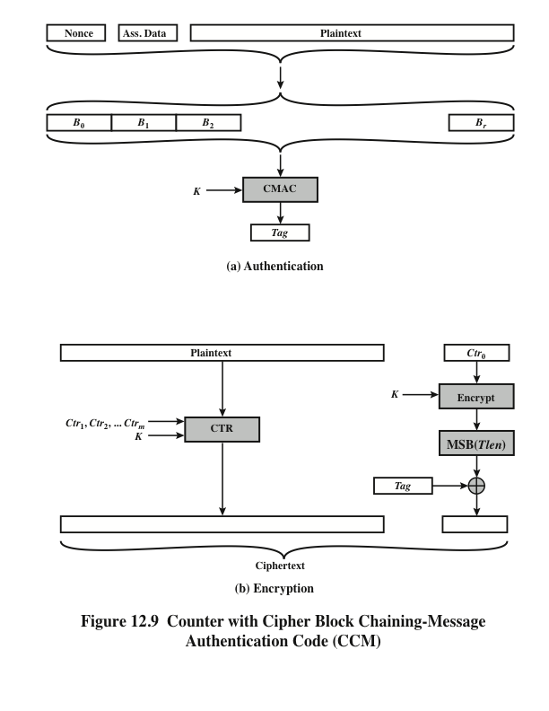
Notes:
Figure 12.9 illustrates the operation of CCM. For authentication, the input
includes the nonce, the associated data, and the plaintext. This input is formatted
as a sequence of blocks B₀ through B_{r} . The first block contains the nonce plus some
formatting bits that indicate the lengths of the N , A , and P elements. This is followed
by zero or more blocks that contain A , followed by zero of more blocks that
contain P . The resulting sequence of blocks serves as input to the CMAC algorithm,
which produces a MAC value with length Tlen , which is less than or equal to the
block length (Figure 12.9a).
For encryption, a sequence of counters is generated that must be independent
of the nonce. The authentication tag is encrypted in CTR mode using the single
counter Ctr₀ . The Tlen most significant bits of the output are XORed with the tag to
produce an encrypted tag. The remaining counters are used for the CTR mode encryption
of the plaintext (Figure 7.7). The encrypted plaintext is concatenated with
the encrypted tag to form the ciphertext output (Figure 12.9b).
CCM is a relatively complex algorithm. Note that it requires two complete
passes through the plaintext, once to generate the MAC value, and once for encryption.
Further, the details of the specification require a tradeoff between the length
of the nonce and the length of the tag, which is an unnecessary restriction. Also
note that the encryption key is used twice with the CTR encryption mode: once to
generate the tag and once to encrypt the plaintext plus tag. Whether these complexities
add to the security of the algorithm is not clear. In any case, two analyses
of the algorithm ([JONS02] and [ROGA03]) conclude that CCM provides a high
level of security.

Slide 29
Galois/Counter Mode (GCM)
NIST standard SP 800-38D
Designed to be parallelizable so that it can provide high throughput with low cost and low latency
Message is encrypted in variant of CTR mode
Resulting ciphertext is multiplied with key material and message length information over GF (2¹²⁸) to generate the authenticator tag
The standard also specifies a mode of operation that supplies the MAC only, known as GMAC
Makes use of two functions:
GHASH - a keyed hash function
GCTR - CTR mode with the counters determined by simple increment by one operation
Notes:
The GCM mode of operation, standardized by NIST in NIST SP 800-38D, is designed
to be parallelizable so that it can provide high throughput with low cost and
low latency. In essence, the message is encrypted in variant of CTR mode. The resulting
ciphertext is multiplied with key material and message length information
over GF(2¹²⁸ ) to generate the authenticator tag. The standard also specifies a mode
of operation that supplies the MAC only, known as GMAC.
The GCM mode makes use of two functions: GHASH, which is a keyed hash
function, and GCTR, which is essentially the CTR mode with the counters determined
by a simple increment by one operation.

Slide 30
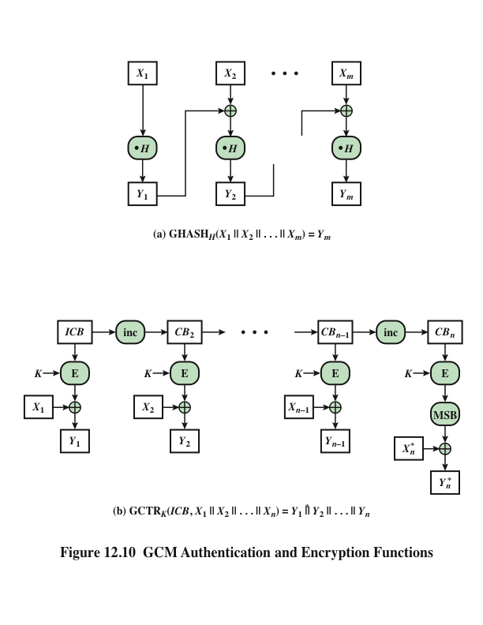
Notes:
GHASH_{H}(X) takes a input the hash key H and a bit string X such that len(X) = 128m bits for some positive integer m and produces a 128-bit MAC value. The function may be specified as shown in Figure 12.10a. The GHASH H(X) function can be expressed as:
(X₁ • H^{m} ) XOR (X₂ • H^{m–1} ) XOR ... XOR (X_{m–1} • H² ) XOR (X_{m} • H)
where • designates multiplication in GF(2¹²⁸ )
This formulation has desirable performance implications. If the same hash key is to be used to authenticate multiple messages, then the values H², H³ can be precalculated one time for use with each message to be authenticated. Then, the blocks of the data to be authenticated (X₁, X₂, … X_{m}) can be processed in parallel, because the computations are independent of one another.
GCTR_{K}(ICB, X) takes a input a secret key K and a bit string X arbitrary length and returns a ciphertext Y of bit length len(X). The function may be specified as as shown in Figure 12.10b. Here the inc₃₂(S) function increments the rightmost 32 bits of S by 1 mod 2³², and the remaining bits are unchanged. Note that the counter values can be quickly generated and that the encryption operations can be performed in parallel.

Slide 31
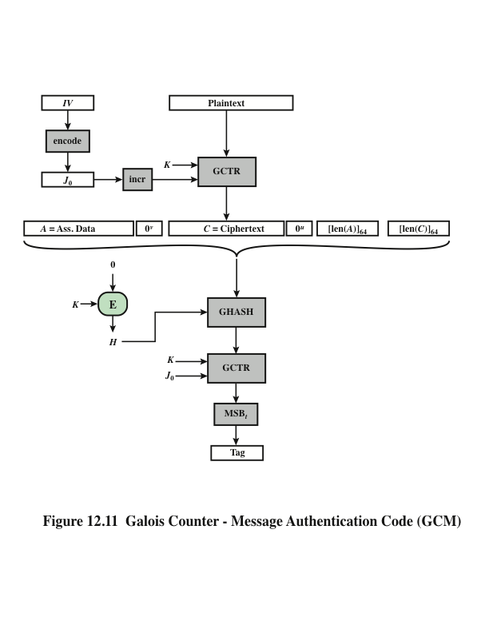
Notes:
We can now define the overall authenticated encryption function as shown in Figure 12.11. The input consists of a secret key K, an initialization vector IV, a plaintext P, and additional authenticated data A.
In step 1, the hash key is generated by encrypting a block of all zeros with the secret key K. In step 2, the pre-counter block (J₀) is generated from the IV. In particular, when the length of the IV is 96 bits, then the padding string 0³¹ || 1 is appended to the IV to form the pre-counter block. Otherwise, the IV is padded with the minimum number of 0 bits, possibly none, so that the length of the resulting string is a multiple of 128 bits (the block size); this string in turn is appended with 64 additional ‘0’ bits, followed by the 64-bit representation of the length of the IV, and the GHASH function is applied to the resulting string to form the pre-counter block.
Thus, GCM is based on the CTR mode of operation, and adds a MAC that authenticates both the message and additional data that requires only authentication. The function that computes the hash uses only multiplication in a Galois field. This choice was made because the operation of multiplication is easy to perform within a Galois field and is easily implemented in hardware. CTR- based authenticated encryption is the most efficient mode of operation for high-speed packet networks. The GCM mode meets a high level of security requirements.

Slide 32
Key Wrap (KW)
Most recent block cipher mode of operation defined by NIST
Uses AES or triple DEA as the underlying encryption algorithm
Purpose is to securely exchange a symmetric key to be shared by two parties, using a symmetric key already shared by those parties
The latter key is called a key encryption key (KEK)
Robust in the sense that each bit of output can be expected to depend in a nontrivial fashion on each bit of input
Only used for small amounts of plaintext
Notes:
The most recent block cipher mode of operation defined by NIST is the Key Wrap
(KW) mode of operation (SP 800-38F), which uses AES or triple DEA as the underlying
encryption algorithm. The AES version is also documented in RFC 3394.
The purpose of key wrapping is to securely exchange a symmetric key to be
shared by two parties, using a symmetric key already shared by those parties. The
latter key is called a key encryption key (KEK) .
Two questions need to be addressed at this point. First, why do we need to
use a symmetric key already known to two parties to encrypt a new symmetric key?
Such a requirement is found in a number of protocols described in this book, such
as the key management portion of IEEE 802.11 and IPsec. Quite often, a protocol
calls for a hierarchy of keys, with keys lower on the hierarchy used more frequently,
and changed more frequently to thwart attacks. A higher-level key, which is used infrequently
and therefore more resistant to cryptanalysis, is used to encrypt a newly
created lower-level key so that it can be exchanged between parties that share the
higher-level key.
The second question is, why do we need a new mode? The intent of the new
mode is to operate on keys whose length is greater than the block size of the encryption
algorithm. For example, AES uses a block size of 128 bits but can use a key
size of 128, 192, or 256 bits. In the latter two cases, encryption of the key involves
multiple blocks. We consider the value of key data to be greater than the value of
other data, because the key will be used multiple times, and compromise of the
key compromises all of the data encrypted with the key. Therefore, NIST desired
a robust encryption mode. KW is robust in the sense that each bit of output can be
expected to depend in a nontrivial fashion on each bit of input. This is not the case
for any of the other modes of operation that we have described. For example, in
all of the modes so far described, the last block of plaintext only influences the last
block of ciphertext. Similarly, the first block of ciphertext is derived only from the
first block of plaintext.
To achieve this robust operation, KW achieves a considerably lower throughput
than the other modes, but the tradeoff may be appropriate for some key
management applications. Also, KW is only used for small amounts of plaintext
compared to, say, the encryption of a message or a file.

Slide 33
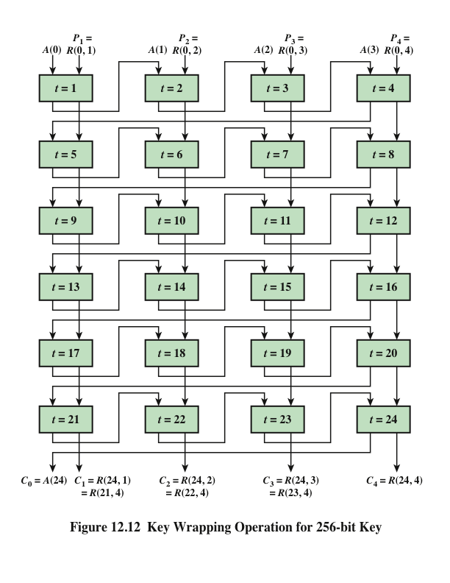
Notes:
Figure 12.12 illustrated the key wrapping algorithm for encrypting a 256-bit
key.

Slide 34
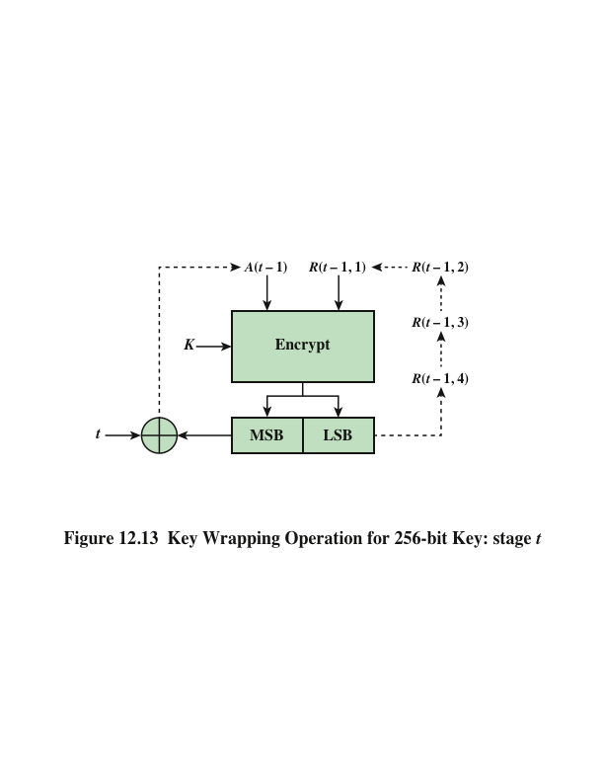
Notes:
Figure 12.13 depicts the operation of stage t for a 256-bit key. The dashed
feedback lines indicate the assignment of new values to the stage variables.

Slide 35
Pseudorandom Number Generation Using Hash Functions and MACs
Essential elements of any pseudorandom number generator (PRNG) are a seed value and a deterministic algorithm for generating a stream of pseudorandom bits
If the algorithm is used as a pseudorandom function (PRF) to produce a required value, the seed should only be known to the user of the PRF
If the algorithm is used to produce a stream encryption function, the seed has the role of a secret key that must be known to the sender and the receiver
A hash function or MAC produces apparently random output and can be used to build a PRNG
Notes:
The essential elements of any pseudorandom number generator (PRNG) are a seed
value and a deterministic algorithm for generating a stream of pseudorandom bits.
If the algorithm is used as a pseudorandom function (PRF) to produce a required
value, such as a session key, then the seed should only be known to the user of the
PRF. If the algorithm is used to produce a stream encryption function, then the seed
has the role of a secret key that must be known to the sender and the receiver.
We noted in Chapters 8 and 10 that, because an encryption algorithm produces
an apparently random output, it can serve as the basis of a (PRNG). Similarly,
a hash function or MAC produces apparently random output and can be used to
build a PRNG. Both ISO standard 18031 (Random Bit Generation ) and NIST SP
800-90 (Recommendation for Random Number Generation Using Deterministic
Random Bit Generators ) define an approach for random number generation using
a cryptographic hash function. SP 800-90 also defines a random number generator
based on HMAC.

Slide 36
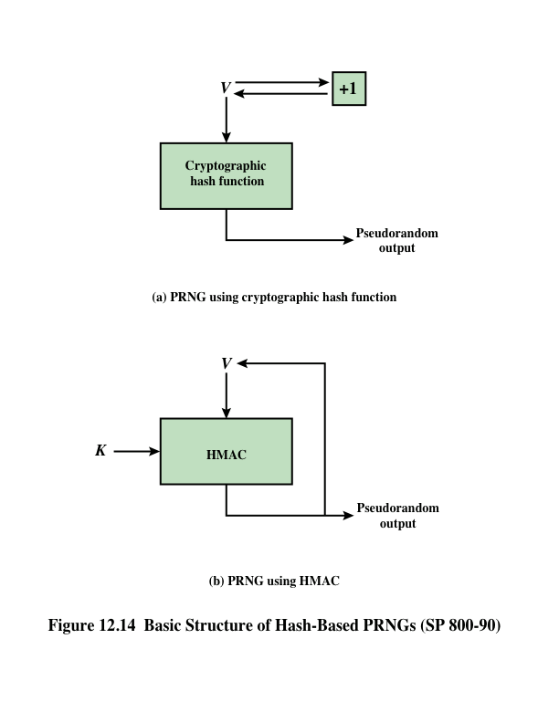
Notes:
Figure 12.14a shows the basic strategy for a hash-based PRNG specified in SP 800-
90 and ISO 18031.
The SP 800-90 specification also provides for periodically updating V to enhance
security. The specification also indicates that there are no known or suspected
weaknesses in the hash-based approach for a strong cryptographic hash algorithm,
such as SHA-2.
Although there are no known or suspected weaknesses in the use of a cryptographic
hash function for a PRNG in the manner of Figure 12.14a, a higher degree of confidence
can be achieved by using a MAC. Almost invariably, HMAC is used for
constructing a MAC-based PRNG. This is because HMAC is a widely used standardized
MAC function and is implemented in many protocols and applications.
As SP 800-90 points out, the disadvantage of this approach compared to the hash based
approach is that the execution time is twice as long, because HMAC involves
two executions of the underlying hash function for each output block. The advantage
of the HMAC approach is that it provides a greater degree of confidence in its
security, compared to a pure hash-based approach.
For the MAC-based approach, there are two inputs: a key K and a seed V . In
effect, the combination of K and V form the overall seed for the PRNG specified
in SP 800-90. Figure 12.14b shows the basic structure of the PRNG mechanism, and
the leftmost column of Figure 12.15 shows the logic. Note that the key remains the
same for each block of output, and the data input for each block is equal to the tag
output of the previous block. The SP 800-90 specification also provides for periodically
updating K and V to enhance security.

Slide 37
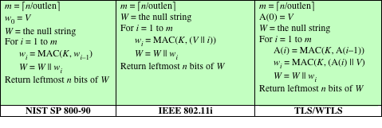
Notes:
It is instructive to compare the SP 800-90 recommendation with the use of
HMAC for a PRNG in some applications, and this is shown in Figure 12.15. For the
IEEE 802.11i wireless LAN security standard (Chapter 18), the data input consists
of the seed concatenated with a counter. The counter is incremented for each block
wi of output. This approach would seem to offer enhanced security compared to the
SP 800-90 approach. Consider that for SP 800-90, the data input for output block
wi is just the output wi-1 of the previous execution of HMAC. Thus, an opponent
who is able to observe the pseudorandom output knows both the input and output
of HMAC. Even so, with the assumption that HMAC is secure, knowledge of the
input and output should not be sufficient to recover K and hence not sufficient to
predict future pseudorandom bits.
The approach taken by the Transport Layer Security protocol (Chapter 17)
and the Wireless Transport Layer Security Protocol (Chapter 18) involves invoking
HMAC twice for each block of output wi . As with IEEE 802.11, this is done in such
a way that the output does not yield direct information about the input. The double
use of HMAC doubles the execution burden and would seem to be security overkill.

Slide 38
Summary
Message authentication requirements
Message authentication functions
Message encryption
Message authentication code
Requirements for message authentication codes
Security of MACs
Brute-force attacks
Cryptanalysis
Pseudorandom number generation using hash functions and MACs
MACs based on hash functions: (HMAC)
HMAC design objectives
HMAC algorithm
Security of HMAC
MACS based on block ciphers: DAA and CMAC
Authentication encryption: CCM and GCM
Key wrapping
Background
Key wrapping algorithm
Key unwrapping
Notes:
Chapter 12 summary.

